Slide 1
Effects of AP medication on cortical thickness and normative brain organization

Slide 2
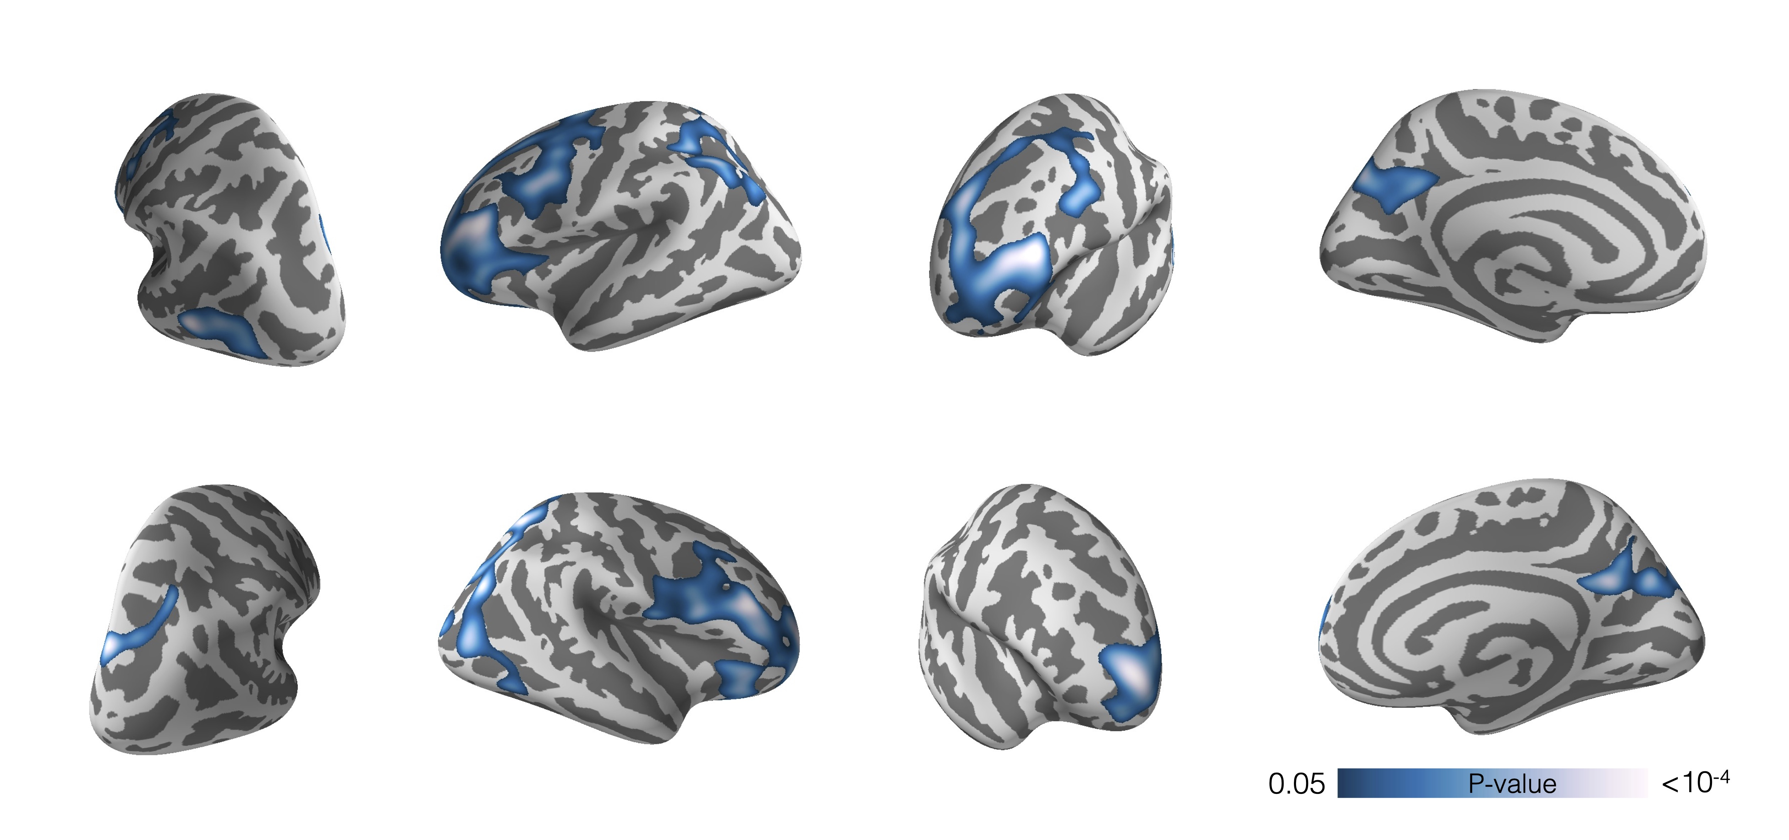
Figure 1 Association between lifetime antipsychotic exposure and cortical thickness. Higher lifetime AP exposure is associated with
lower cortical thickness in prefrontal cortex, parietal cortex and posterior
cingulate cortex, N=131. Model includes age, sex, and diagnostic group as nuisance variables. Colorbar indicates p-value and results are permutation corrected for multiple comparisons.

Slide 3
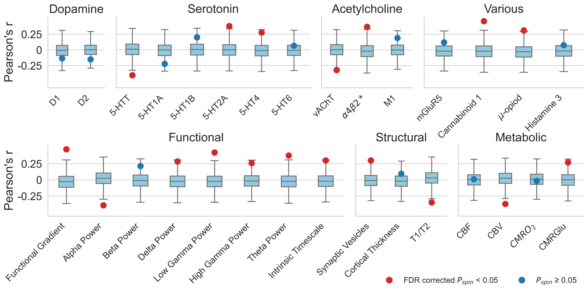
Figure 2 Regional sensitivity to antipsychotic exposure and underlying brain features. Correlations between the effects of lifetime antipsychotic exposure and normative brain features in the discovery sample (Turku sample) are shown. Several features were statistically associated with antipsychotic related cortical thinning and these associations survived false discovery rate (FDR) correction for multiple comparisons. These measures include serotonergic, cholinergic, structural, functional, structural, and metabolic features. Positive correlation indicates that regions that have a higher value of the measured brain feature are more susceptible to the effects of antipsychotics than regions that have a lower value and vice versa. The dots show Pearson’s correlation coefficient r between antipsychotics effects and a given brain feature, the color of the dot indicates statistical significance. The ends of the boxes represent the first and third quartiles and the center line represents the median of the null distribution (10,000 rotations), the whiskers represent the non-outlier end-points of the distribution

Slide 4
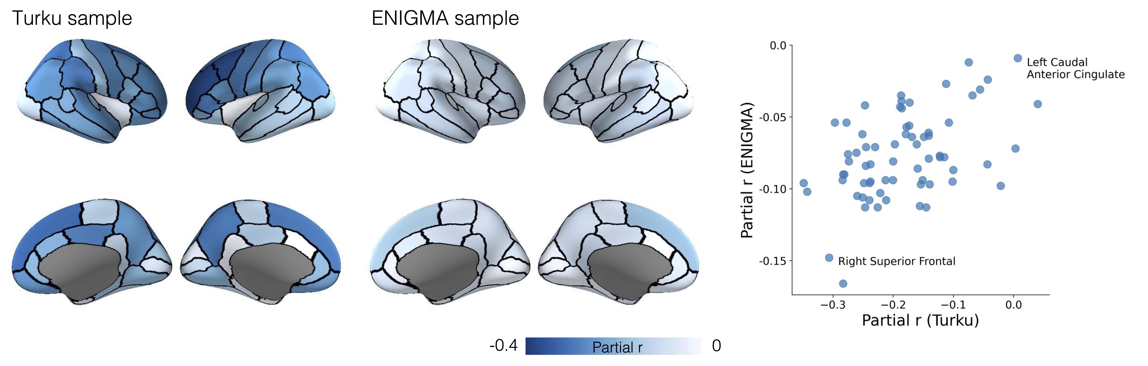
Figure 3 Parcel-wise associations between antipsychotic medication and cortical thickness in the Turku and ENIGMA samples. In the Turku sample, mean cortical thickness in each parcel and lifetime antipsychotic exposure are correlated while controlling for age, sex, and diagnostic group. In the ENIGMA sample, correlation between mean cortical thickness in each parcel and current antipsychotic dose is calculated while controlling for age and sex. Colorbar indicates partial correlation r. Spatial correlation of AP effects on cortical thickness is similar between the two samples (Pearson’s r=0.47, p_{spin} = 0.0008). Two regions with high and low sensitivity to antipsychotics are labeled in the scatter plot.

Slide 5
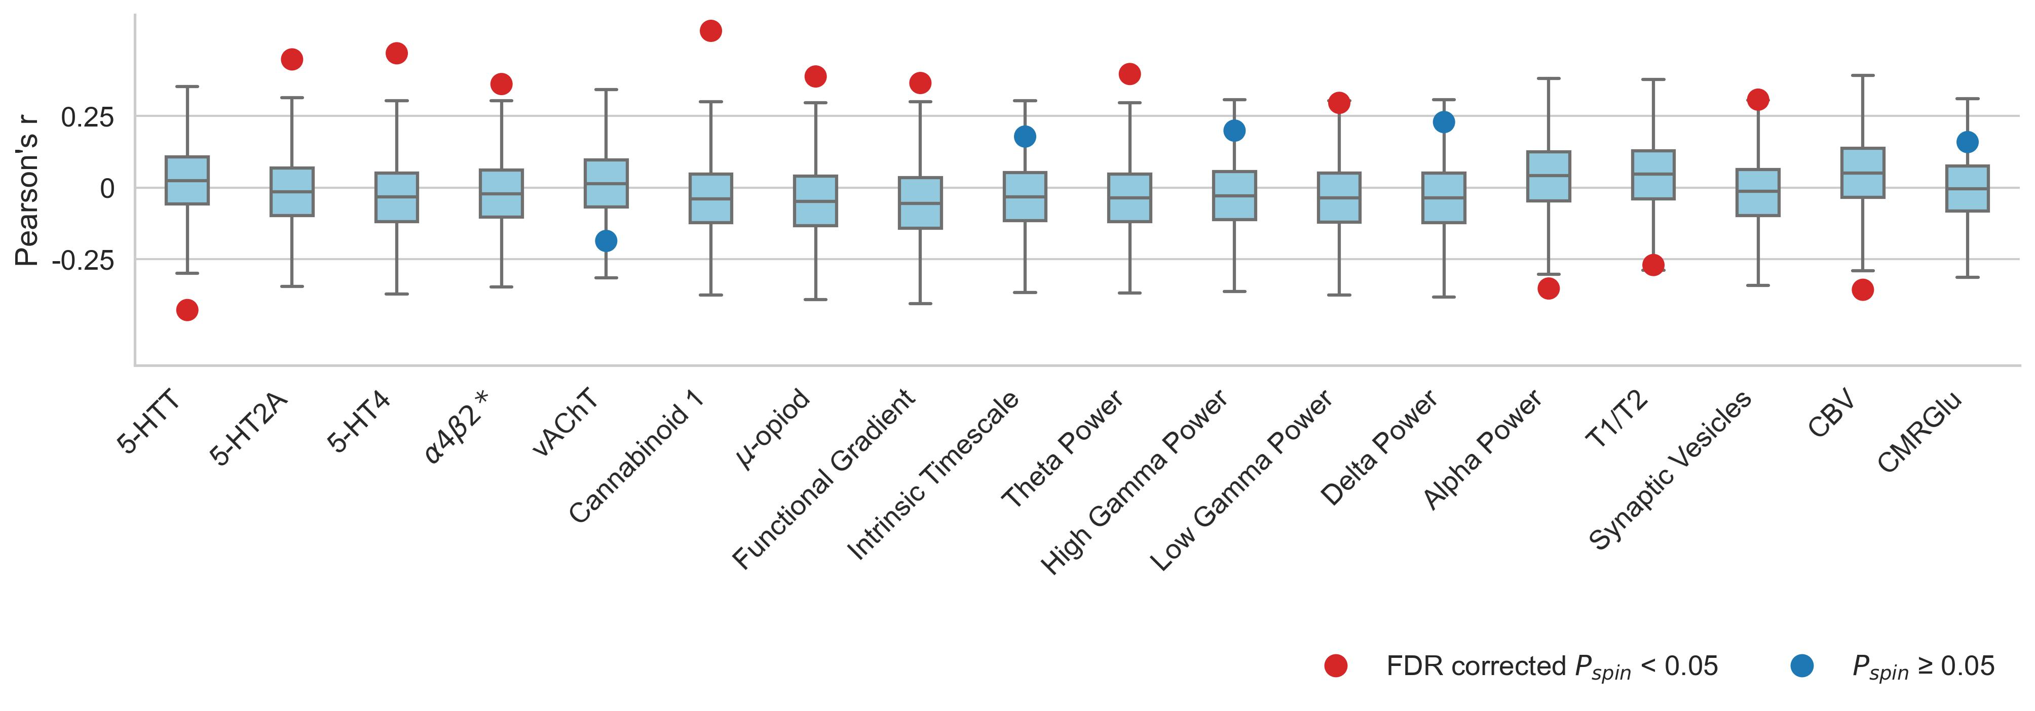
Figure 4 Antipsychotic sensitivity and brain organization replicated in the ENIGMA data. Eighteen normative features of the brain discovered in the discovery sample were selected for a replication analysis. Associations between antipsychotic related cortical thinning and several molecular, functional, structural and metabolic features were replicated and survived false discovery rate correction for multiple comparisons in the ENIGMA sample. The dots show Pearson’s correlation coefficient r between antipsychotics effects and a given brain feature, the color of the dot indicates statistical significance. In the boxplots the ends of the boxes represent the first and third quartiles, the center line represents the median of the null distribution (10,000 rotations), the whiskers represent the non-outlier end-points of the distribution

Slide 6
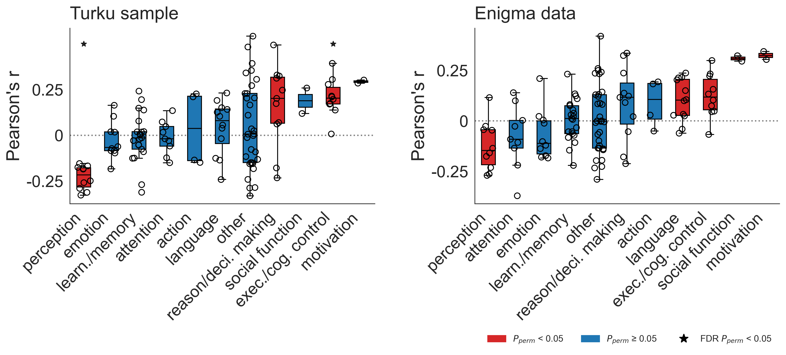
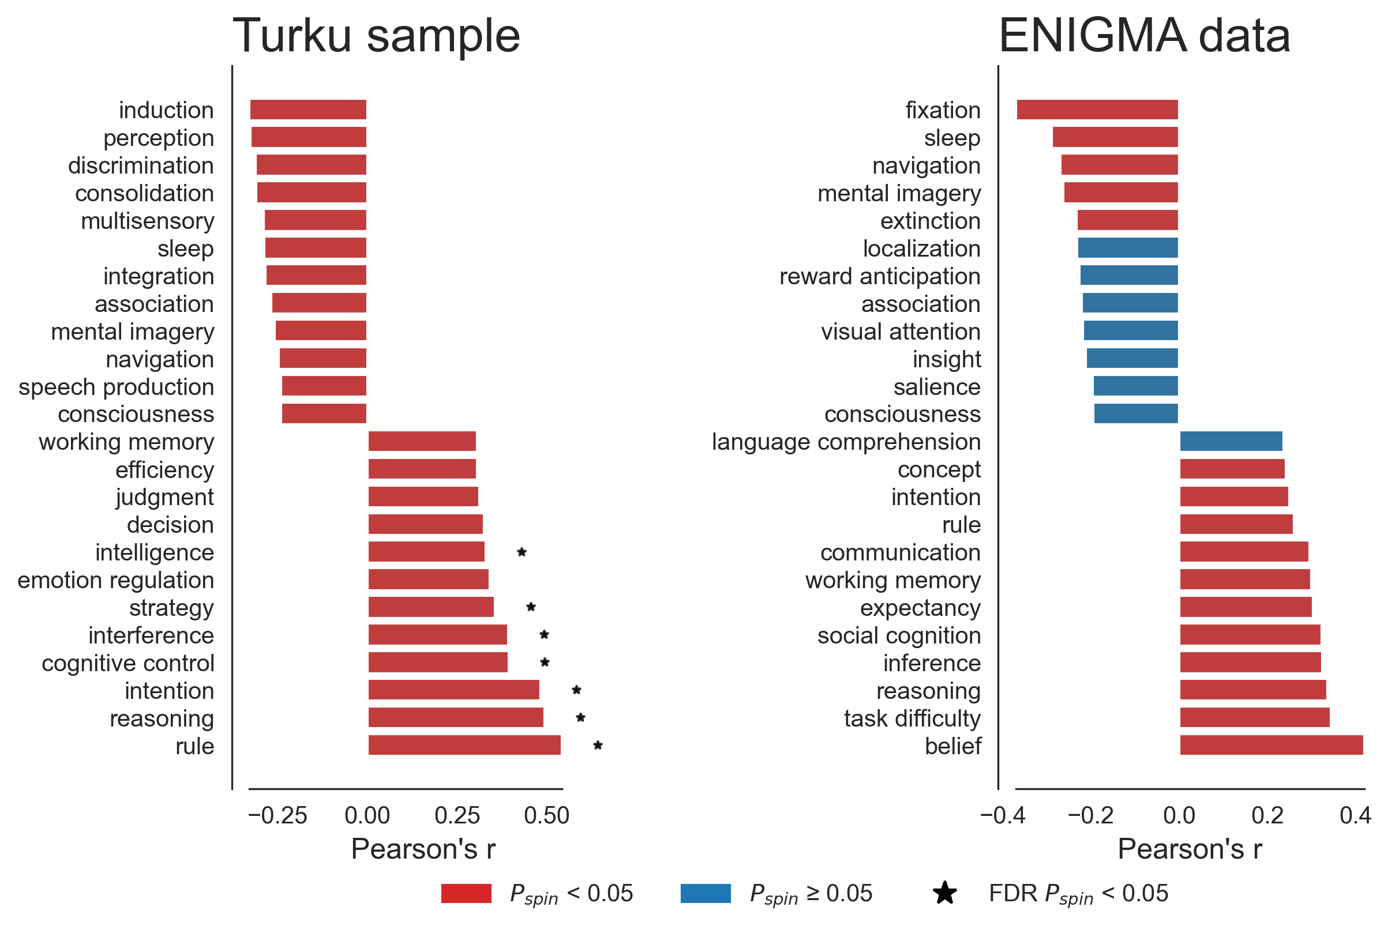
A)
B)
Figure 5 Antipsychotic related cortical thinning and cognitive functions. Probabilistic maps for 123 different cognitive functions were derived from neurosynth database and correlated with antipsychotic related cortical thinning. In the Panel A, he cognitive functions were grouped into 11 categories and ranked based on average correlation. In the Turku sample, we found that functions related to ‘perception’ were negatively correlated and ‘reasoning / decision making’, ‘executive / cognitive control ’ and ’motivation’ were positively correlated with antipsychotic related cortical thinning (two-sided permutation test over groupings). Similarly, in the ENIGMA data, ‘perception’, ‘executive / cognitive control ’, and ‘motivation’, but also ‘language’ and ‘social function’ were associated with antipsychotic related cortical thinning. Top and bottom 10 % of the strongest individual term correlations in both samples are shown in the Panel B.

Slide 7
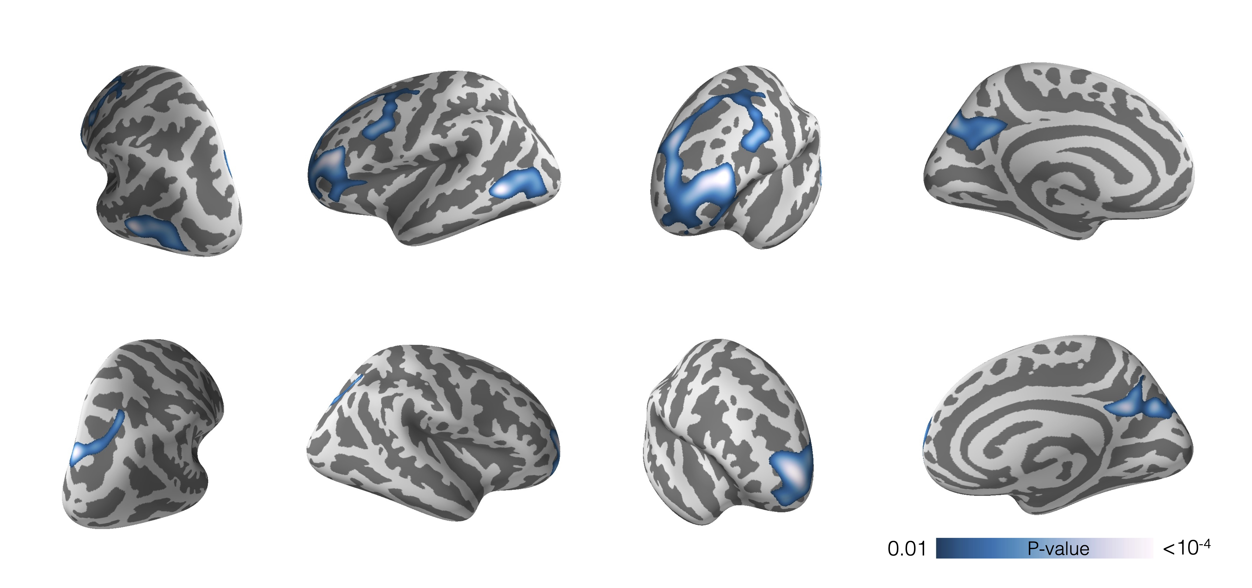
Supplementary Figure 1 Association between lifetime antipsychotic exposure and cortical thickness thresholded at p=0.01. Model includes age, sex, and diagnostic group as nuisance variables. Colorbar indicates p-value. Results are permutation corrected for multiple comparisons.

Slide 8
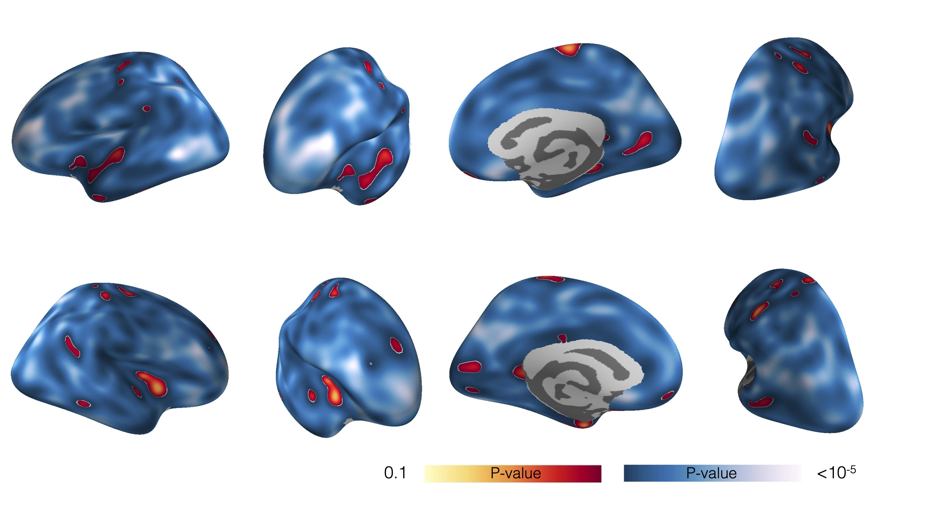
Supplementary Figure 2 Untresholded association between lifetime antipsychotic exposure and cortical thickness. Model includes age, sex, and diagnostic group as nuisance variables. Colorbar indicates p-value.

Slide 9
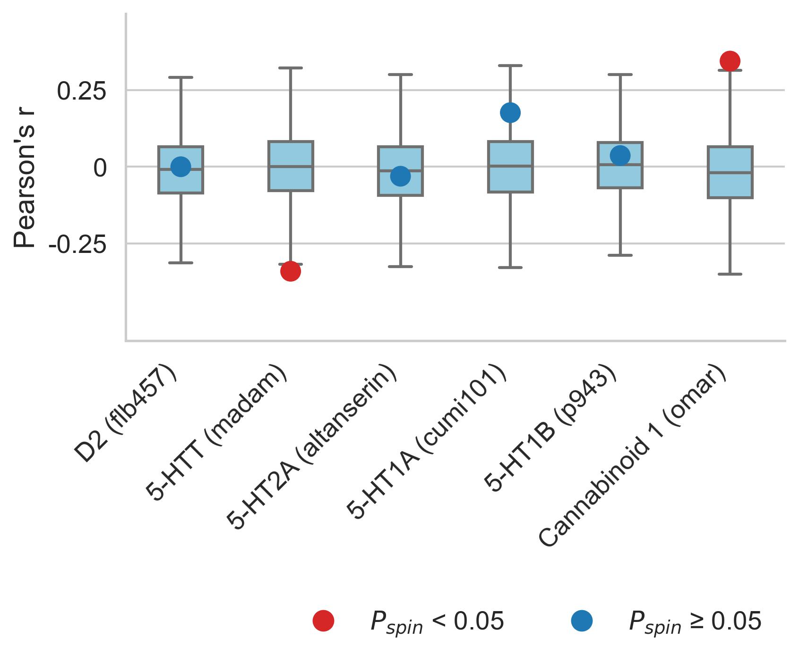
Supplementary Figure 3 Antipsychotic sensitivity and brain organization with additional measures. Six features of brain organization were measured with more than one tracer. For the sake of completeness, these measures were also correlated with AP effects on cortical thickness in the Turku sample. In line with the analysis using the primary measures for these features, no statistically significant associations were found.

Slide 10
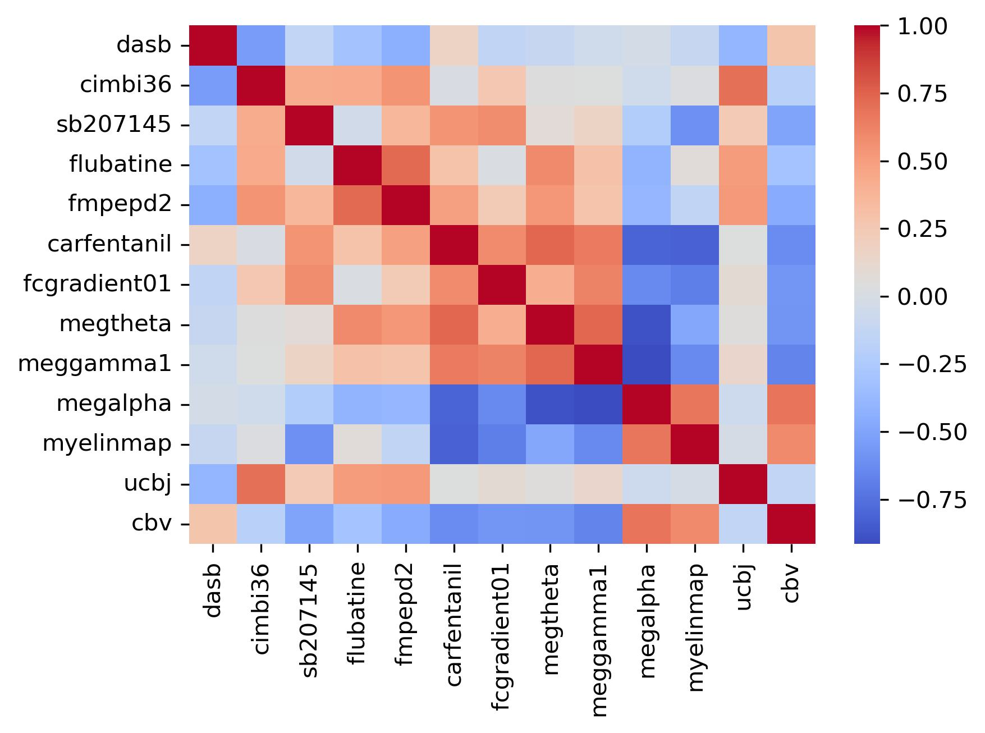
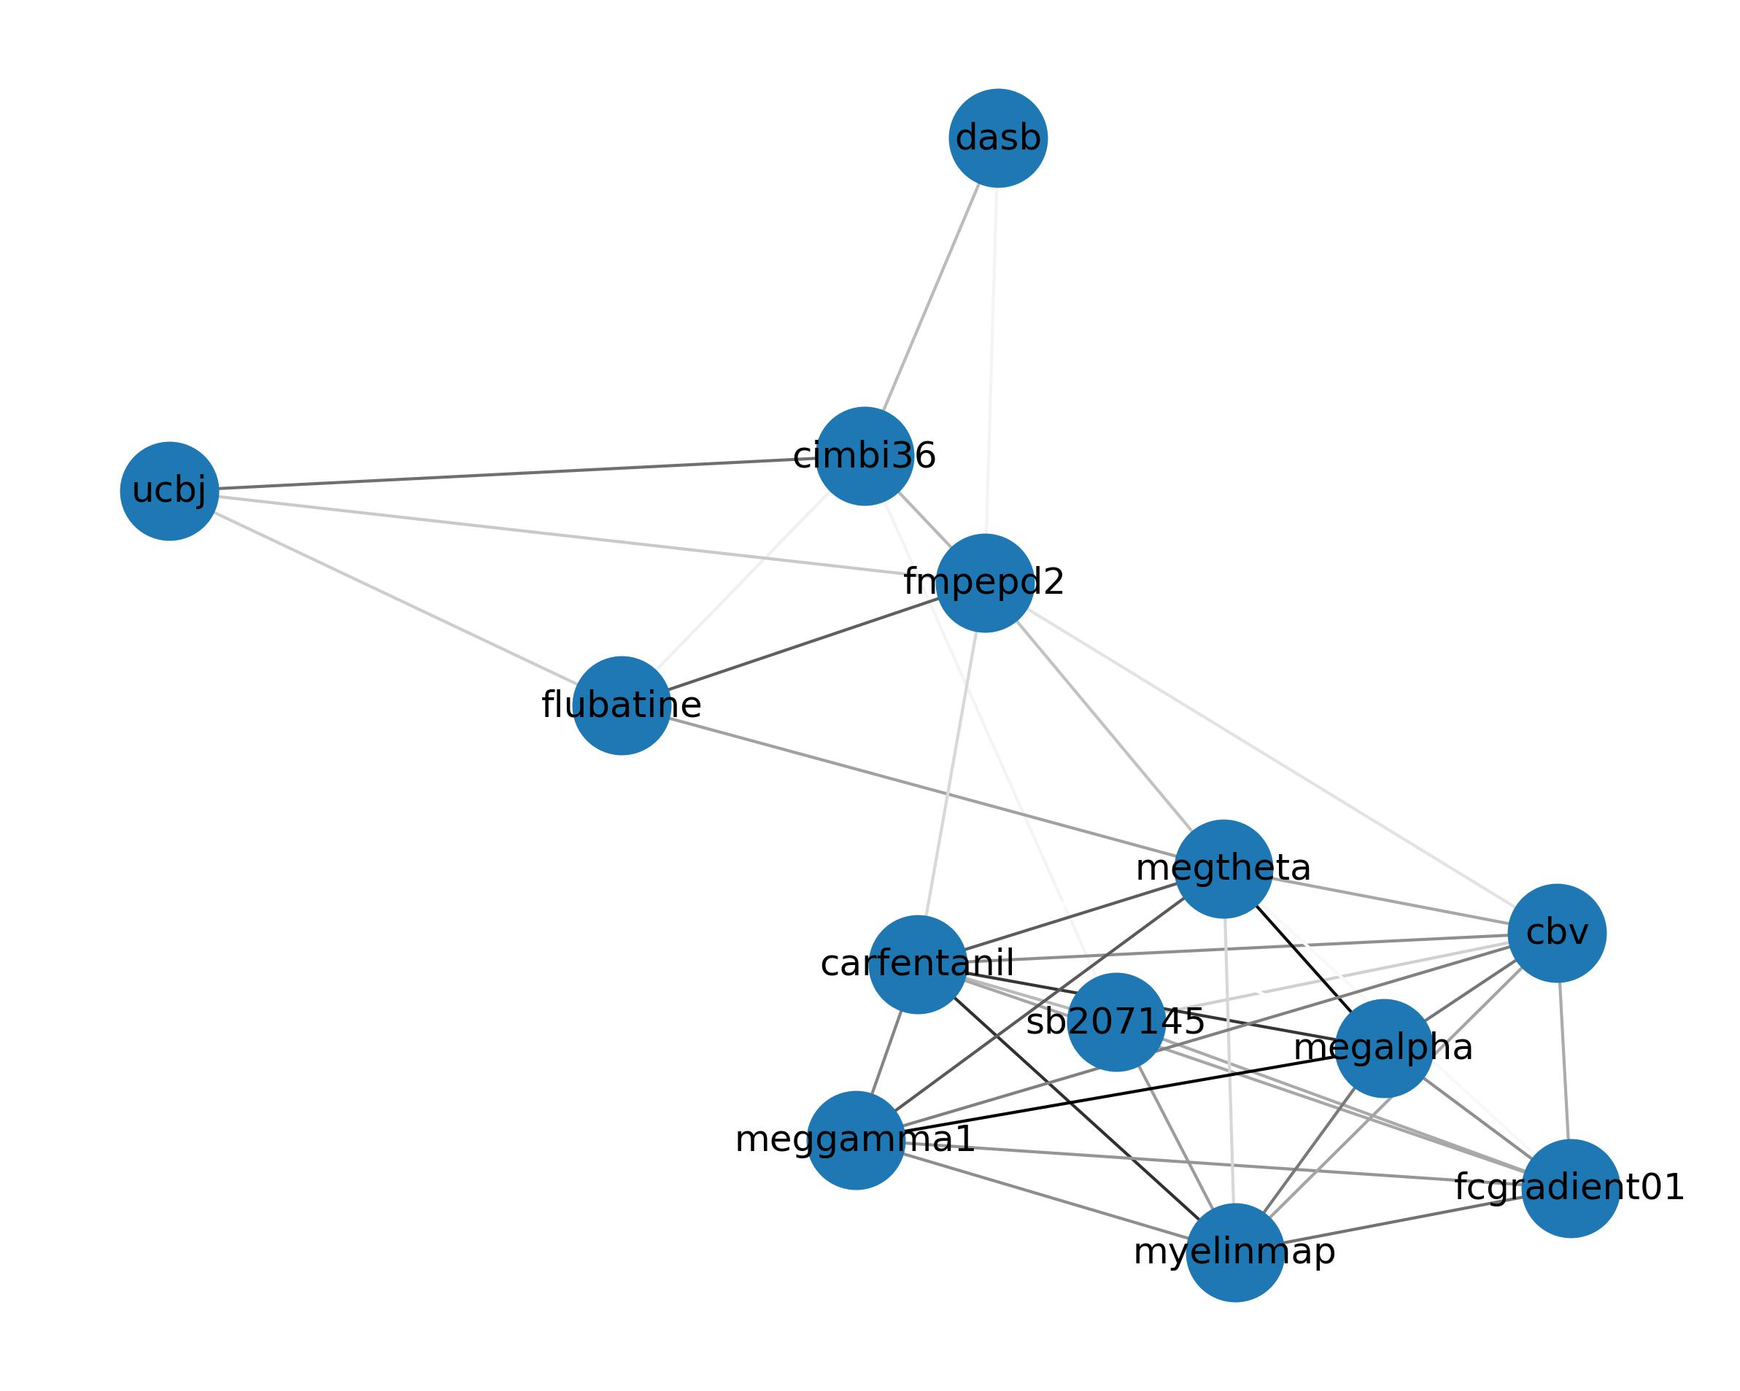
Supplementary Figure 4 Correlations between features of the brain that are associated with antipsychotic related cortical thinning. Left panel show correlation matrix. Right panel shows a spring-embedded representation of the correlations

Slide 11
Supplementary table 1 shows the estimate, standard error, t-value and p-value of antipsychotic exposure on average cortical thickness when including one of the covariates at a time in the model.
Covariate | Estimate | Std. Error | t-value | p-value
Total symptoms score | -1.2E-06 | 2.5E-07 | -4.77 | 0.0000053
Positive symptoms score | -1.2E-06 | 2.6E-07 | -4.60 | 0.0000106
Negative symptoms score | -1.2E-06 | 2.5E-07 | -4.86 | 0.0000036
BMI | -1.1E-06 | 2.5E-07 | -4.30 | 0.0000347
Hospital days | -1.0E-06 | 3.1E-07 | -3.31 | 0.0012269
Times admitted | -1.1E-06 | 2.8E-07 | -3.72 | 0.0003040
GAF | -1.2E-06 | 2.8E-07 | -4.12 | 0.0000688
SOFAS | -1.2E-06 | 2.8E-07 | -4.19 | 0.0000532
BMI=Body Mass Index, GAF=Global Assessment of Functioning,
SOFAS=Social and Occupational Functioning Assessment Scale

Slide 12
Supplementary table 2 shows correlations between antipsychotic related cortical thinning and normative features of the brain in the discovery sample (same data as in figure 2)
source | class | target | rho | pspin | fdr_corrected_p_value
kaller2017_sch23390 | dopamine | D1 | -0.13611309816019400 | 0.2522747725227480 | 0.31534346565343500
jaworska2020_fallypride | dopamine | D2 | -0.15145839192235800 | 0.1648835116488350 | 0.21506544997674100
beliveau2017_dasb | serotonin | 5-HTT | -0.4041914204738630 | 0.0017998200179982 | 0.007713514362849430
savli2012_way100635 | serotonin | 5-HT1A | -0.2230886044601000 | 0.06729327067293270 | 0.1062525326414730
beliveau2017_az10419369 | serotonin | 5-HT1B | 0.19896995442264000 | 0.1095890410958900 | 0.14943960149439600
beliveau2017_cimbi36 | serotonin | 5-HT2A | 0.377865933841217 | 0.0011998800119988000 | 0.007199280071992800
beliveau2017_sb207145 | serotonin | 5-HT4 | 0.27514812603014100 | 0.018998100189981000 | 0.03562143785621440
radnakrishnan2018_gsk215083 | serotonin | 5-HT6 | 0.06486864703669620 | 0.593040695930407 | 0.6354007456397220
tuominen_feobv | acetylcholine | vAChT | -0.321011588836917 | 0.006299370062993700 | 0.017180100171801000
hillmer2016_flubatine | acetylcholine | $\alpha4 \beta2*$ | 0.3662865373866890 | 0.004899510048995100 | 0.014998500149985000
naganawa2020_lsn3172176 | acetylcholine | M1 | 0.18914965240899800 | 0.0948905109489051 | 0.13555787278415000
dubois2015_abp688 | various | mGluR5 | 0.11861066017734100 | 0.32836716328367200 | 0.39404059594040600
laurikainen2018_fmpepd2 | various | Cannabinoid 1 | 0.45584978842246300 | 0.000999900009999 | 0.007199280071992800
kantonen2020_carfentanil | various | $\mu$-opiod | 0.308922119988958 | 0.014698530146985300 | 0.029397060293970600
gallezot2017_gsk189254 | various | Histamine 3 | 0.07465882818090720 | 0.5506449355064490 | 0.611827706118277
margulies2016_fcgradient01 | functional | Functional Gradient | 0.4736608549761900 | 9.99900009999E-05 | 0.0029997000299970000
hcps1200_megalpha | functional | Alpha Power | -0.39369935598264800 | 0.0016998300169983000 | 0.007713514362849430
hcps1200_megbeta | functional | Beta Power | 0.21379662504879700 | 0.0842915708429157 | 0.12643735626437400
hcps1200_megdelta | functional | Delta Power | 0.28439367925684500 | 0.014298570142985700 | 0.029397060293970600
hcps1200_meggamma1 | functional | Low Gamma Power | 0.4230748599315880 | 0.0005999400059994000 | 0.007199280071992800
hcps1200_meggamma2 | functional | High Gamma Power | 0.25983323129290300 | 0.0212978702129787 | 0.037584476846433
hcps1200_megtheta | functional | Theta Power | 0.3769190538769740 | 0.004999500049995000 | 0.014998500149985000
hcps1200_megtimescale | functional | Intrinsic Timescale | 0.3007630887583380 | 0.008599140085991400 | 0.021497850214978500
finnema2016_ucbj | structural | Synaptic Vesicles | 0.30075589867662100 | 0.009499050094990500 | 0.021920884834593500
hcps1200_thickness | structural | Cortical Thickness | 0.09457914724924790 | 0.42295770422957700 | 0.4880281202648970
hcps1200_myelinmap | structural | T1/T2 | -0.34840135738894000 | 0.0038996100389961000 | 0.014623537646235400
raichle_cbf | metabolic | CBF | 0.009795333069901100 | 0.9342065793420660 | 0.9342065793420660
raichle_cbv | metabolic | CBV | -0.37187655201844700 | 0.0011998800119988000 | 0.007199280071992800
raichle_cmr02 | metabolic | $CMRO_2$ | -0.014991231074433000 | 0.9032096790320970 | 0.9342065793420660
raichle_cmruglu | metabolic | CMRGlu | 0.26999789426642900 | 0.022897710228977100 | 0.038162850381628500

Slide 13
Supplementary table 3 shows correlations between antipsychotic related cortical thinning and alternative tracers (same data as in supplementary figure 3)
source | class | target | rho | pspin
sandiego2015_flb457 | dopamine | D2 | -5.79697230025378E-05 | 0.9996000399960000
fazio2016_madam | serotonin | 5-HTT | -0.34088637208110100 | 0.0040995900409959
beliveau2017_cumi101 | serotonin | 5-HT1A | -0.031009435680068000 | 0.7922207779222080
savli2012_p943 | serotonin | 5-HT1B | 0.17632035708924800 | 0.138986101389861
savli2012_altanserin | serotonin | 5-HT2A | 0.036385225482637400 | 0.7381261873812620
normandin2015_omar | various | Cannabinoid 1 | 0.34450355205267800 | 0.005099490050994900

Slide 14
Supplementary table 4 shows correlations between antipsychotic related cortical thinning and normative features of the brain in the replication sample (same data as in figure 4)
source | class | target | rho | pspin | fdr_corrected_p_value
beliveau2017_dasb | serotonin | 5-HTT | -0.42730137785045700 | 0.00039996000399960000 | 0.0035996400359964000
beliveau2017_cimbi36 | serotonin | 5-HT2A | 0.44723884247094900 | 0.00029997000299970000 | 0.0035996400359964000
beliveau2017_sb207145 | serotonin | 5-HT4 | 0.4685705038863450 | 0.0010998900109989000 | 0.004949505049495050
hillmer2016_flubatine | acetylcholine | $\alpha4 \beta2*$ | 0.361200659937138 | 0.0028997100289971 | 0.007456397217421110
tuominen_feobv | acetylcholine | vAChT | -0.18615621847142200 | 0.12138786121387900 | 0.13892360763923600
laurikainen2018_fmpepd2 | various | Cannabinoid 1 | 0.5468469740436400 | 0.0005999400059994000 | 0.0035996400359964000
kantonen2020_carfentanil | various | $\mu$-opiod | 0.38768215355838800 | 0.0025997400259974 | 0.007456397217421110
margulies2016_fcgradient01 | functional | Functional Gradient | 0.3648219948521910 | 0.006199380061993800 | 0.012398760123987600
hcps1200_megtimescale | functional | Intrinsic Timescale | 0.17808098151252700 | 0.16498350164983500 | 0.16498350164983500
hcps1200_megtheta | functional | Theta Power | 0.3962061791475740 | 0.0016998300169983000 | 0.006119388061193880
hcps1200_meggamma2 | functional | High Gamma Power | 0.19868373094673000 | 0.12348765123487700 | 0.13892360763923600
hcps1200_meggamma1 | functional | Low Gamma Power | 0.2956246730624560 | 0.0188981101889811 | 0.028347165283471700
hcps1200_megdelta | functional | Delta Power | 0.22859793901970000 | 0.0822917708229177 | 0.10580370534375100
hcps1200_megalpha | functional | Alpha Power | -0.35220229889986500 | 0.0053994600539946000 | 0.012148785121487900
hcps1200_myelinmap | structural | T1/T2 | -0.2702431372254100 | 0.033996600339966 | 0.047072215855337500
finnema2016_ucbj | structural | Synaptic Vesicles | 0.3068443681943620 | 0.0091990800919908 | 0.015053040150530400
raichle_cbv | metabolic | CBV | -0.3566093662360660 | 0.007799220077992200 | 0.014038596140386000
raichle_cmruglu | metabolic | CMRGlu | 0.15876486313861500 | 0.1643835616438360 | 0.16498350164983500

Slide 15
Supplementary table 5 showing all the antipsychotic medications that were used in the Turku sample
and a number of patients that were ever exposed to these antipsychotics.
 | FEP | CHR
Second generation antipsychotics
risperidone (n) | 50 | 12
quetiapine (n) | 35 | 13
olanzapine (n) | 31 | 7
aripiprazole (n) | 12 | 3
paliperidone (n) | 5 | 0
asenapine (n) | 4 | 0
ziprasidone (n) | 1 | 0
sulpride (n) | 1 | 0
First generation antipsychotics
perphenazine (n) | 6 | 2
haloperidol (n) | 3 | 2
flupentixol (n) | 2 | 0
levomepromazine (n) | 2 | 0

Slide 16
Supplementary table 6 shows measures of normative
structural and functional features of the cortex used in this study.
Author/Dataset | Year | Tracer / Measure | Target
Jaworska | 2020 | fallypride | D2
Kaller | 2017 | sch23390 | D1
Radnakrishnan | 2018 | gsk215083 | 5-HT6
Beliveau | 2017 | cimbi36 | 5-HT2A
Savli | 2012 | way100635 | 5-HT1A
Beliveau | 2017 | az10419369 | 5-HT1B
Beliveau | 2017 | sb207145 | 5-HT4
Fazio | 2016 | madam | 5-HTT
Tuominen | NA | feobv | vAChT
Hillmer | 2016 | flubatine | alpha4 beta2* nAChR
Naganawa | 2020 | lsn3172176 | M1 mAChR
Margulies | 2016 | fcgradient01 | Functional Gradient
Mueller | 2013 | intersubjvar | Intersubject Variance
Hcps | 1200 | megalpha | Alpha Power
Hcps | 1200 | megdelta | Delta Power
Hcps | 1200 | megbeta | Beta Power
Hcps | 1200 | meggamma1 | Low Gamma Power
Hcps | 1200 | meggamma2 | High Gamma Power
Hcps | 1200 | megtheta | Theta Power
Hcps | 1200 | megtimescale | Intrinsic Timescale
Finnema | 2016 | ucbj | Synaptic Vesicles
Hcps | 1200 | thickness | Cortical Thickness
Hcps | 1200 | myelinmap | T1/T2
Dukart | 2018 | flumazenil | GABA A
Dubois | 2015 | abp688 | mGluR5
Laurikainen | 2018 | fmpepd2 | Cannabinoid 1
Kantonen | 2020 | carfentanil | mu-opiod
Gallezot | 2017 | gsk189254 | Histamine 3
Raichle | NA | cbf | CBF
Raichle | NA | cbv | CBV
Raichle | NA | cmr02 | CMRO2
Raichle | NA | cmruglu | CMRGlu
For more details please see: https://docs.google.com/spreadsheets/d/1oZecOsvtQEh5pQkIf8cB6CyhPKVrQuko/edit#gid=1162991686

